Slide 1
Sensitivity of Crops to Weather & Climate
Agro-Meteorological Information Systems Development Project
Component-C of Bangladesh Weather and Climate Services Regional Project
Department of Agricultural Extension (DAE), Ministry of Agriculture,Bangladesh

Slide 2
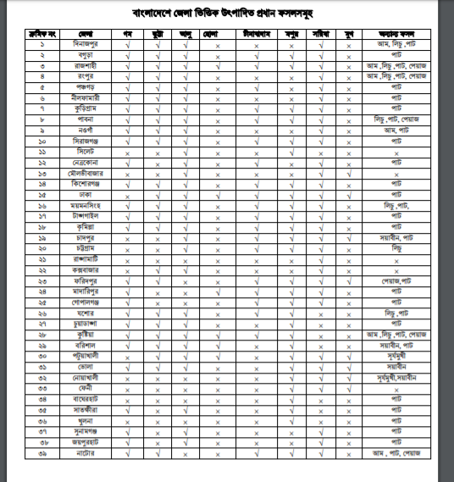
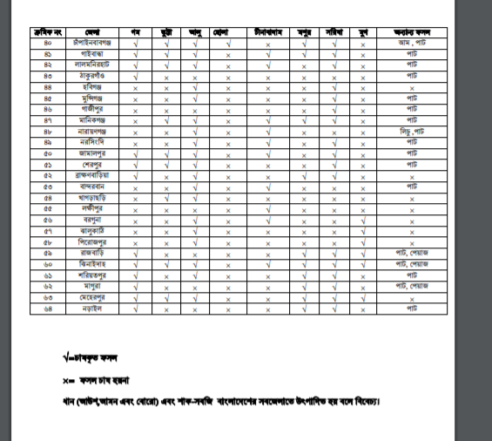
Districtwise Distribution of Major Crops in Bangladesh

Slide 3
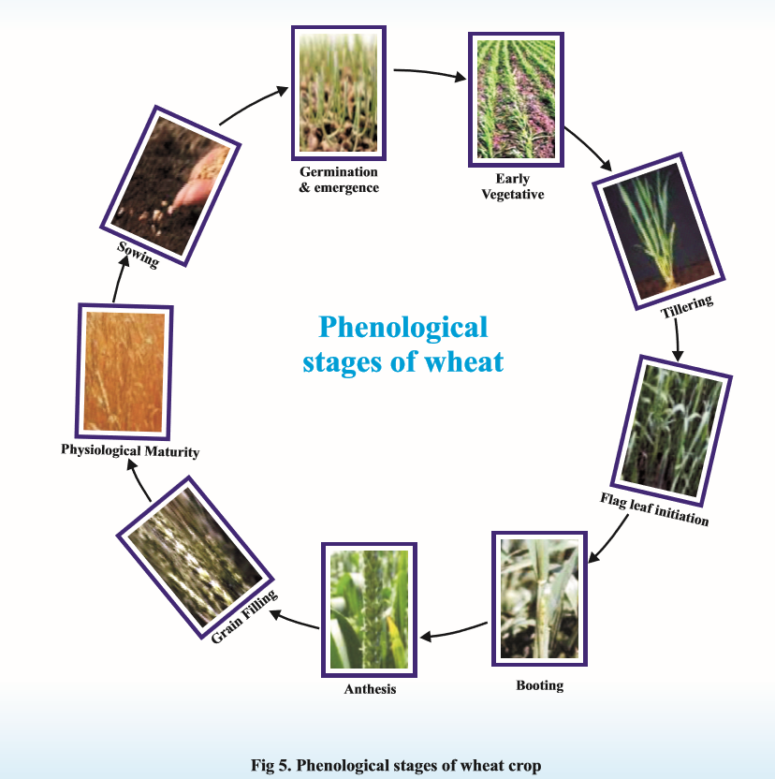

Slide 4
All the crops have their own specific requirement of meteorological parameters at each of their growth stages.
Hence, they have selective response to these parameters. excess or deficiency of these parameters during crop growth stages have effect on them.
The crops are sometimes influenced by one or two factors, which play crucial role at some critical crop growth stages.

Slide 5
Experiments on different dates of sowing can provide useful indication of the climatic requirements as they are accompanied by daily meteorological observations, phenological observations and biometric data on crop.
In the present scenario, towards better agrometeorological advisory services, some tips on agroclimatology of important crops, based on crop weather relationship study, is essentially required for better crop fitting in suitable zone.

Slide 6
Weather/Climate Sensitive to cultivation of crops in Bangladesh
  Sudden floods
  Drought
  Dense Fog
  Dew
  Low Temperature
  Severe Cold Wave
  Heavy rainfall
  Lightning & Thunderstorm
  Stagnation of water
  Storm
  Hailstorm
  High Humidity
  Submergence of crops due to floods/heavy rain
  Incidences of diseases due to high and stormy wind
  Untimely and unusual rainfall
  High temperature

Slide 7
On going practices to protect /modify cultivation based on sensitivity of weather to Crops in Bangladesh
Cover the crops with polythene in case of sever cold and dense fog.
Resowing of crops damaged by floods and drought, heavy rainfall.
Resowing of Nabi variety of rice after receding of flood.
Double transplanting ( Balan padhuti)
Undertake medium and short duration of crops varieties
Preparation of seed bed on high land
Dry seedbed
Irrigation
Remove water from the field through drainage system
Providing support by bamboo from lodging of plant
Production of seedling under polythene shed.
Mulching
Spaying water on plant to save the crop from severe cold and dense fog.
Raising of Bunds
Cultivation of tolerant varieties with respect to aberrant weather
Early sowing and early harvesting
Mode of cultivation of crops based on the decision in the farmers’ gathering
Use of light and pheromone traps for control of insects
Use of pesticides and fungicides to control pests and diseases under the favourable conditions for its incidence
Cultivation of crops as per rge weather forecast

Slide 8
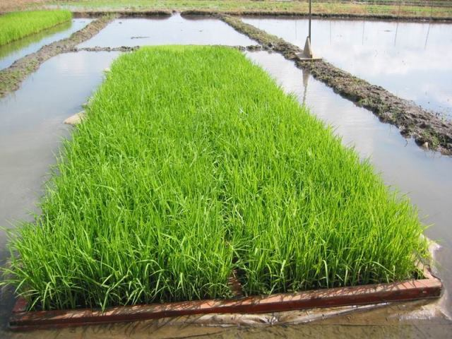
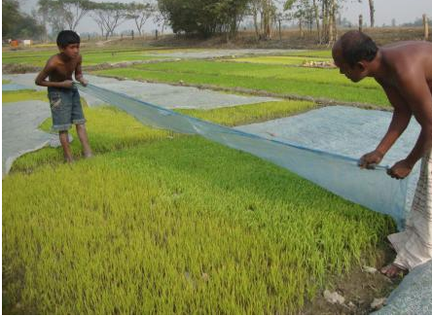
Sensitivity of Boro Paddy under Cold Wave
Cold wave hampers germination of Boro Paddy.
Cover the entire nursery bed in the day time with polythene sheets and remove in the evening to avoid the effect of cool temperatures on germination and growth of nursery. Irrigate the nursery with water in night time and remove water in early morning to speed up nursery growth in cold weather conditions

Slide 9
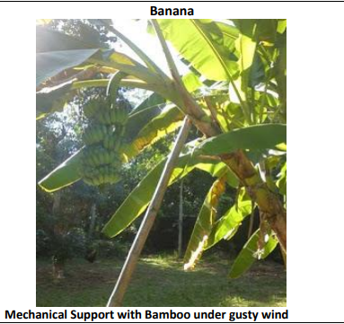

Sensitivity of Banana Plant under High Wind
High wind cause injury to Banana & Sugarcane Crop and Vegetables
Farmers are advised to provide mechanical support to Banana Crop due to expected gusty wind.
Undertake propping in sugarcane, provide mechanical support to young fruit plants and staking of vegetables to prevent the crops from lodging due to strong winds

Slide 10
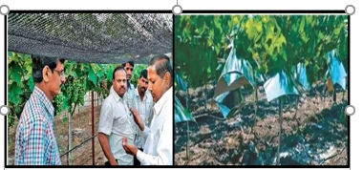
Sensitivity of Standing Crops to Hailstorm
Hail can severely damage all plants including tattered leaves, broken or damaged shoots and wounds on scaffold branches, fruit damage and even fruit being knocked to the ground.
Sensitive leaves of plants become shredded, pock marked or ripped by hail.
In case of new plants which are sprouting and growing tender leaves and stems, hail can completely kill seedlings.
Hail damage to trees shows up as split and broken stems/ branches.
The tips and tops of trees become scarred and pitted by the hail. This can increase the chance of disease, rotting and insect’s infestation.
Before the Hailstorm
Use hail net for orchard crops to protect from hail damage.
Use hailcaps to save the nurseries and young plants
After the Hailstorm
i. To clean up the debris and fallen fruits from orchards and trim off broken stems and leaves of plants to avoid further spread of pest and diseases.
ii. Some plants are too heavily affected and fixing hail damage is not possible. These plants should be removed and replaced with new plants

Slide 11
Solar Radiation & Crop Growth

Slide 12
Meteorological Factors in Photosynthesis
The dry matter of plant is produced through photosynthesis.
There are several environmental factors which regulate the rate of photosynthesis.
Among these, solar radiation, environmental temperature, concentration of carbon dioxide in the atmosphere, moisture status and turbulence are the most important.

Slide 13
Soil Temperature & Plant Growth
Soil temperature is an important environmental factor in plant growth and distribution.
In comparison to air temperature, the amplitude of variations in surface temperature is much more pronounced because of varying characteristics and composition of soil.
Soil temperature, particularly the extremes, influences the germination of seeds, the functional activity of the root system, the incidences of plant diseases and rate of plant growth.

Slide 14
Cardinal Temperature
Three temperature of vital activity have been recognished which are often termed as Cardinal Points.
A minimum temperature below which no growth occurs.
An optimum temperature at which maximum plant growth occurs.
A maximum temperature above which the plant growth stops.

Slide 15
Air Temperature & Plant Growth
Air temperature is the most important climatic variables which affects plant life.
The growth of higher plants is restricted to temperature between 0 and 60 degree centigrade and crop plants are further restricted to narrower range of 10 and 40 degree centigrade.
However, each species and variety has its own upper and lower temperature limit. Beyond these limits, a plant gets considerably damaged and gets even killed.

Slide 16
Growing Degree Days
Growing Degree Days ( GDD), also called heat units, effective heat units or growth units, are simple means of relating plant growth development and maturity to air temperature.
The GDD concept assumes that that there is a direct and linear relationship between growth and temperature.
It starts with the assumption that the growth of plants is dependent on the total amount of heat to which it is subjected during its life time.
GDD is the departure from the mean daily temperature above minimum threshold value The minimum threshold value is the temperature below which growth of plant stops.
Growing Degree Days are calculated as: GDD = ((T max + T min)/2) - T base. If the average temperature for a day is lower than the base temperature, then no Growing Degree Days are counted.

Slide 17
Moisture Factor in Plant Growth

Slide 18
Hail on Crop Growth

Slide 19
Humidity on Crop Growth

Slide 20
Soil Moisture & Crop Growth

Slide 21
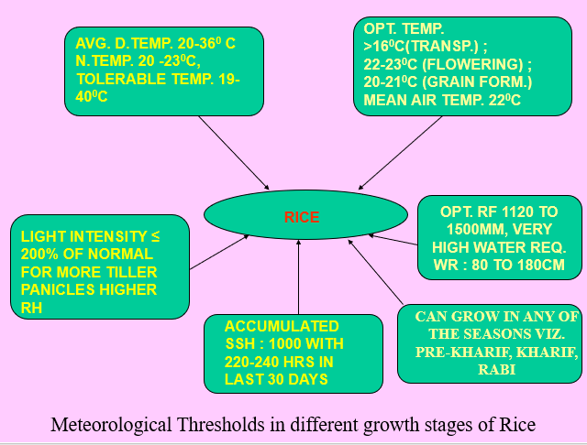
Sensitivity of Rice to weather
Soil temperature above 16⁰C after transplanting is very essential. light intensity upto 200% of normal gives more tillers, panicles and well developed grains.
Higher RH (%) within the crop canopy is usually conducive.
For obtaining the maximum yield the accumulated sunshine hours during the crop span of rice is 1000 with 220 - 240 hours in the last 30 days.
Rice has very high water requirement. optimum well distributed rainfall during its almost 4 months growing period is 1120 to 1500 mm. standing water from end of tillering to grain ripening is useful. the crop is highly sensitive to water deficiency at flowering and heading stages.

Slide 22
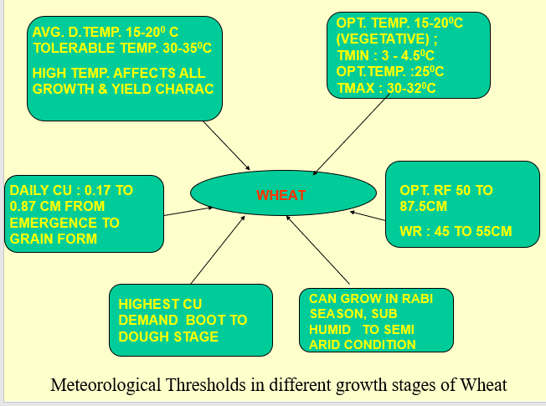
Sensitivity of Wheat to weather
Higher temperatures of about 30 - 35⁰C have in general detrimental effect to the crop performance. the crop can withstand intense cold condition. the optimal range of temperature for the germination of winter wheat and for its vegetative growth is 15 to 20⁰C .
Minimum, optimum and maximum cardinal temperatures for germination of wheat crop are 3 to 4.5⁰C, around 25⁰C and 30- 32⁰C, respectively. high temperature during rapid growth and tillering periods results in poor tillering, low number of effective tillers, poor growth rate, short shoot height, low lai, short ears with lower number of spikelets, lower fertilization, lower grain weight and lower quality

Slide 23
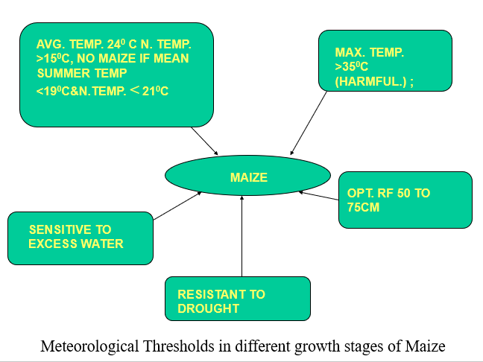
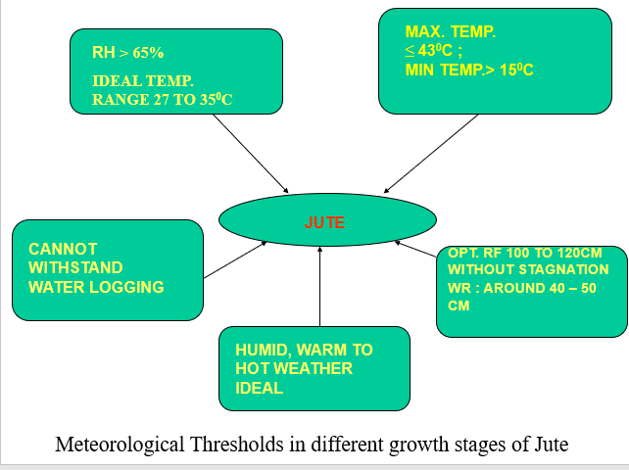
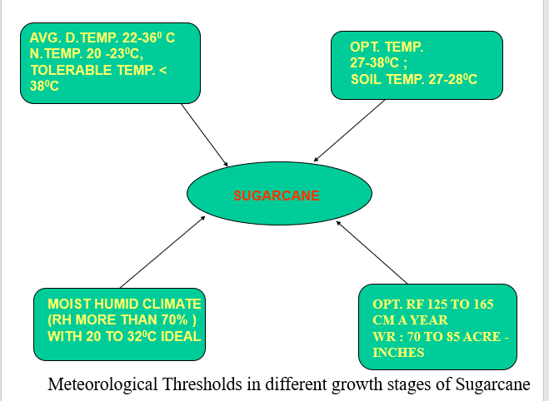
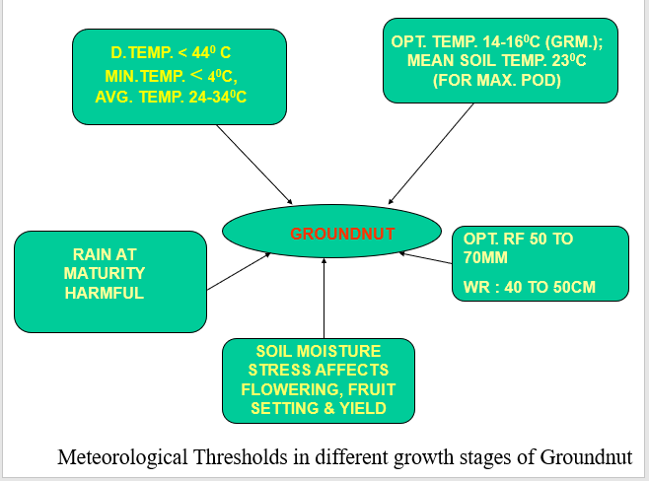
Sensitivity of Maize, Jute, Sugarcane & Groundnut to weather

Slide 24
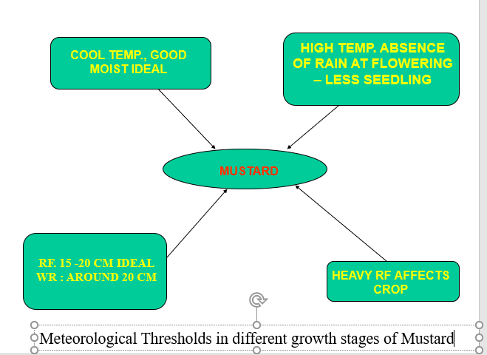
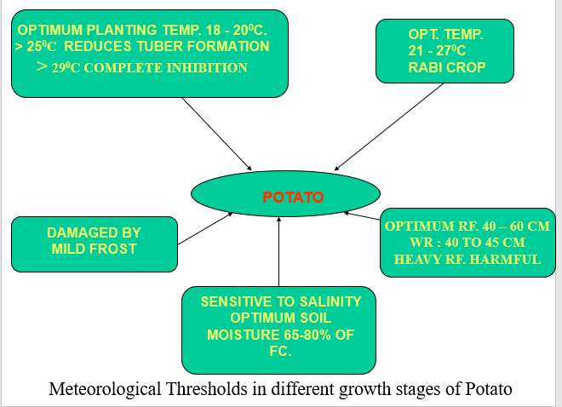
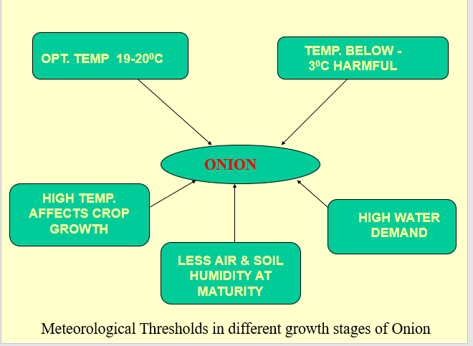
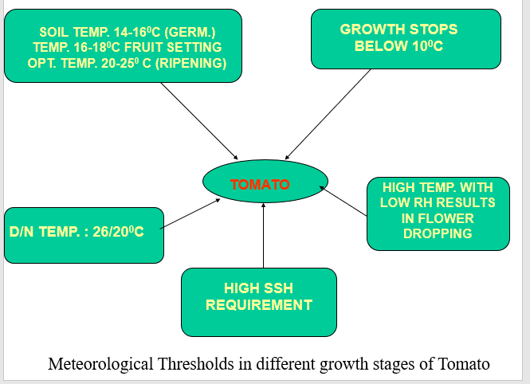
Sensitivity of Mustard, Potato, Tomato & Onion to weather

Slide 25
Crop Weather Calendar
The pictorial representation of detailed information for a crop w.r.t. sowing period and duration of important phenological stages in its life cycle, the optima of climatic requirement during different stages of the crop and the actual and normal weather for that station / location is called the .
A Crop Weather Calendar (CWC) consists of typical life history of the crop, from sowing through vegetative growth, flowering, grain growth to period of maturity.
These CWC provide information on crop growth stages, normal weather for crop growth, warnings to be issued based on prevailing weather conditions, water requirement of crops during their various phytophases, meteorological conditions favourable for development of crop pests and diseases.
These calendars are useful for crop planning, irrigation scheduling and plant protection measures, which are of vital importance for effective crop planning and for maximizing and stabilizing food production in the country.
In a broader perspective over a period of say five years, the concise information contained in these calendars give broad indications of the direction of development which may prove useful to the planners, agricultural administrators, plant breeders and the farmers in formulating policy matters regarding plant breeding, crop adaptation, drought proofing, supplemental irrigation, maximizing the yield etc

Slide 26
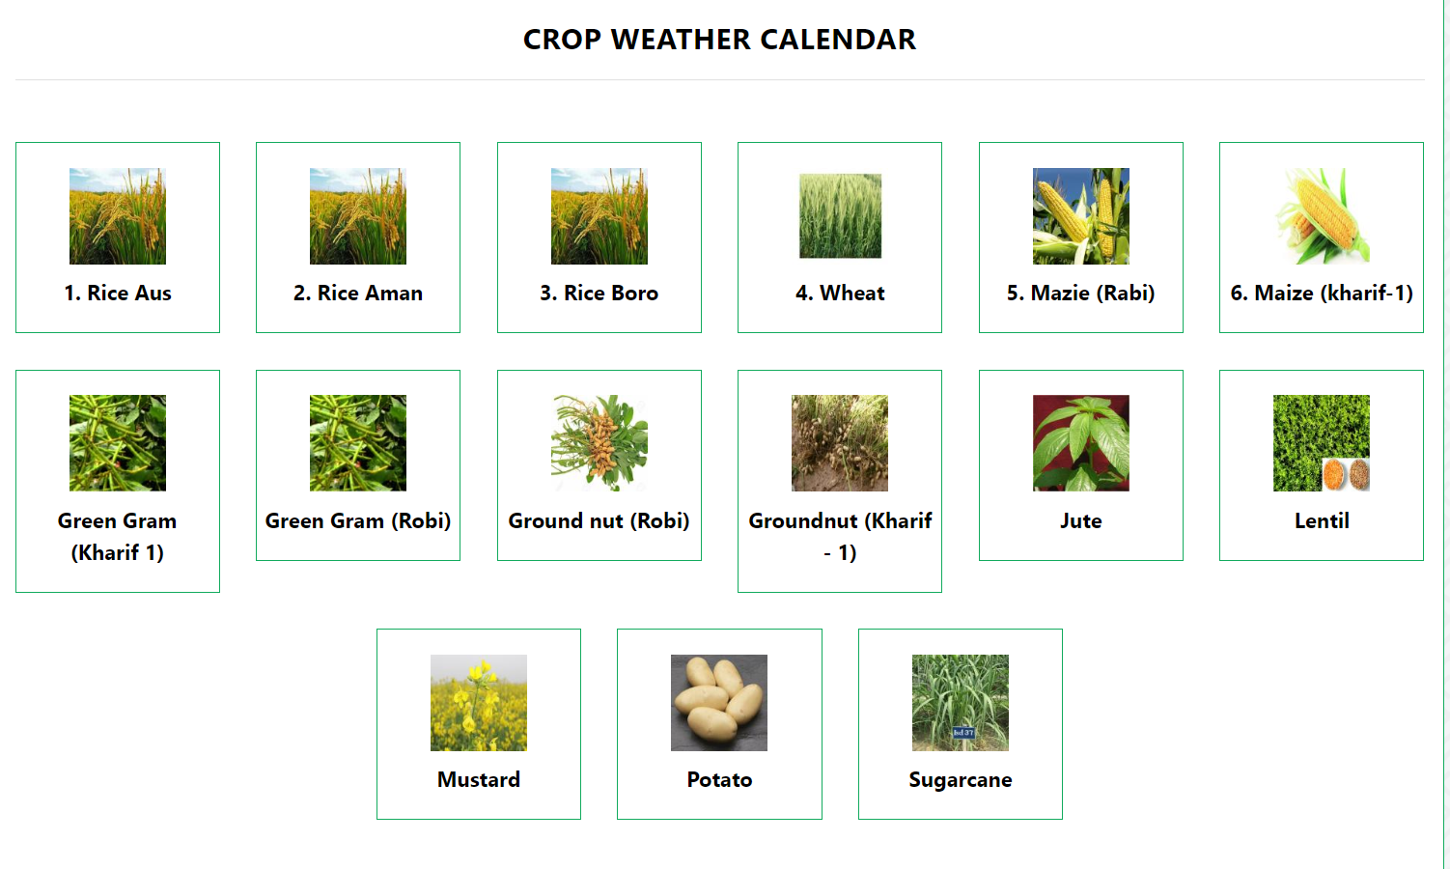

Slide 27
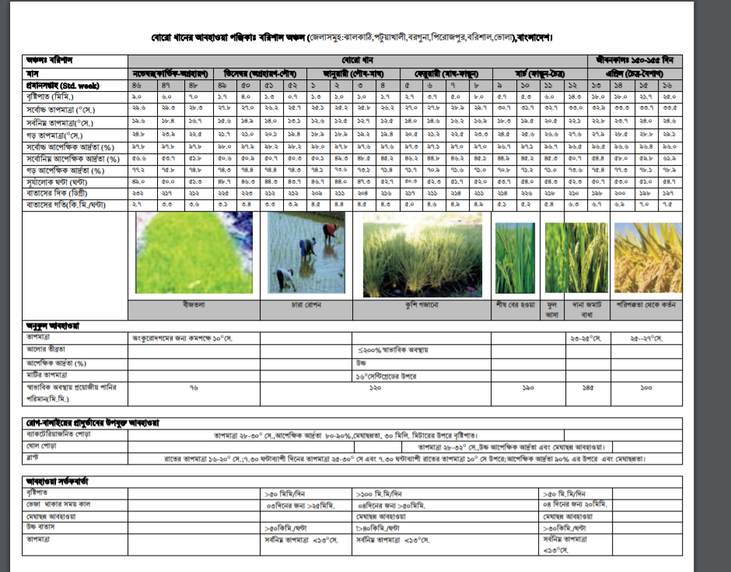

Slide 28
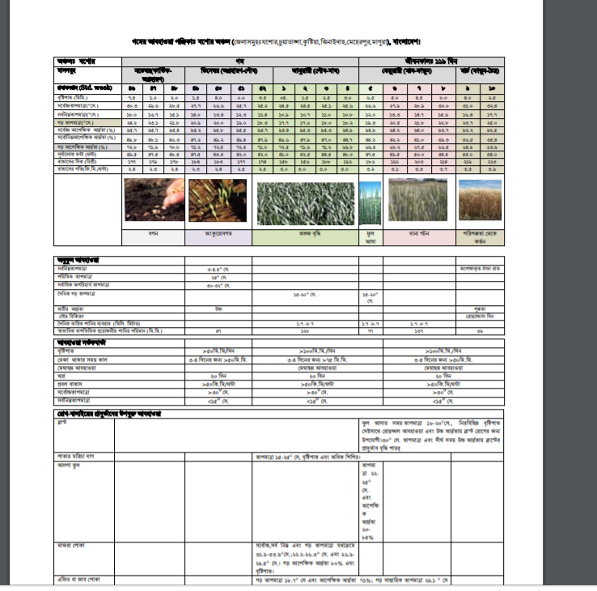

Slide 29
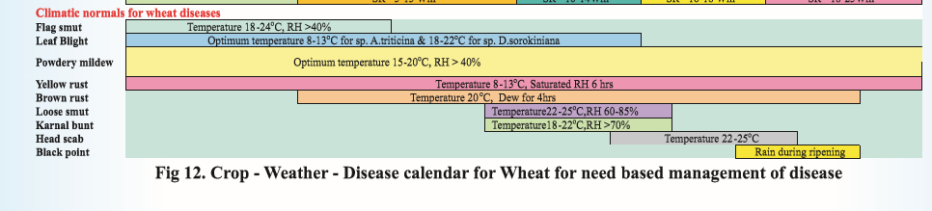
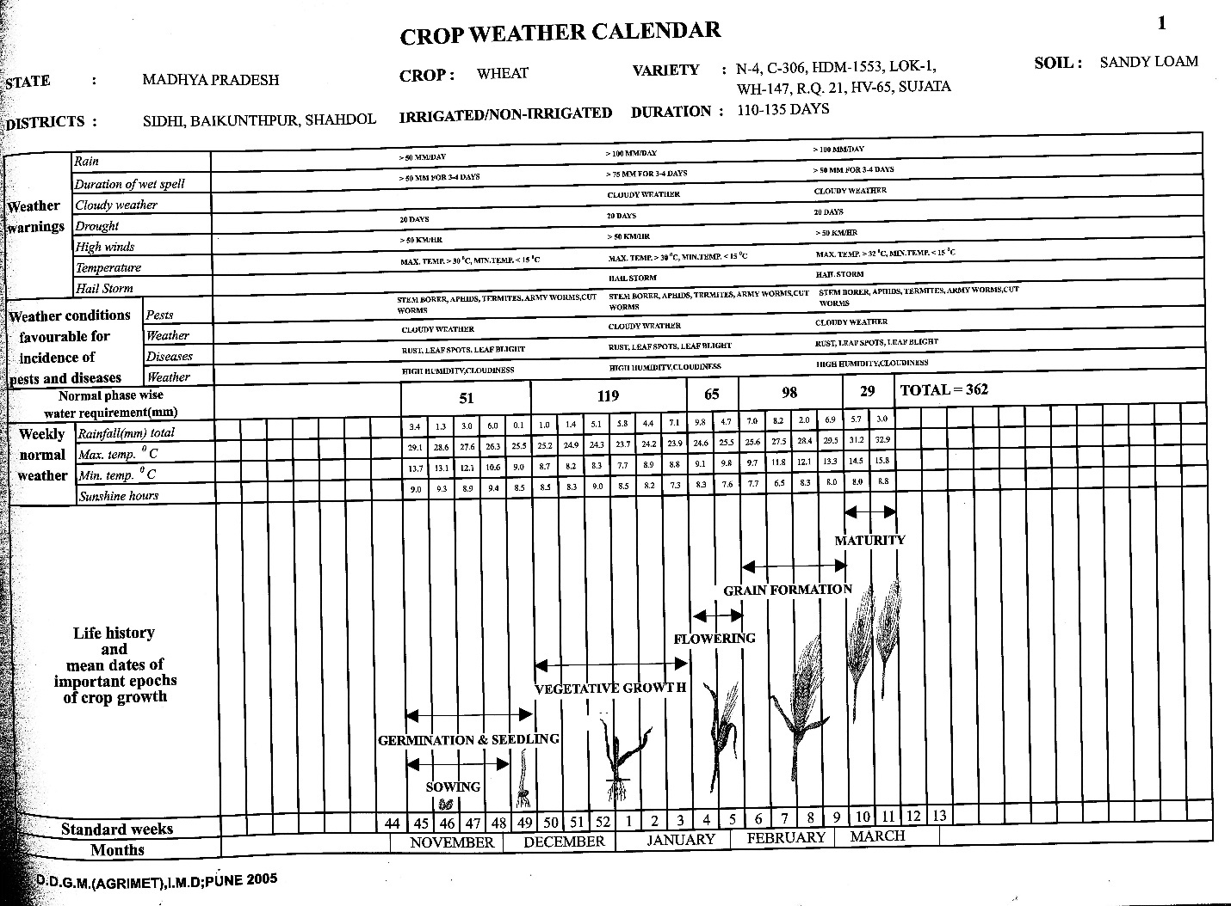
Bright sunny days with dryness and cooler nights during ripening period give better sized quality grains
Can withstand intense cold
Optimum range of germination 15-20⁰C
High temperature of about 30-35⁰C has detrimental effect
Wheat
Highly sensitive to moisture stress from shooting to advanced heading
Shows considerable resistance to drought

Slide 30

ধন্যবাদ

